Slide 1
CHAPTER 3:BUSINESS BASICS AND CHEMISTRY IN INDUSTRY

Slide 2


Slide 3
Definition of Business
Business is the activity of making one's living or making money by producing or buying and selling products (such as goods and services). It is also "any activity or enterprise entered into for profit.”

Slide 4
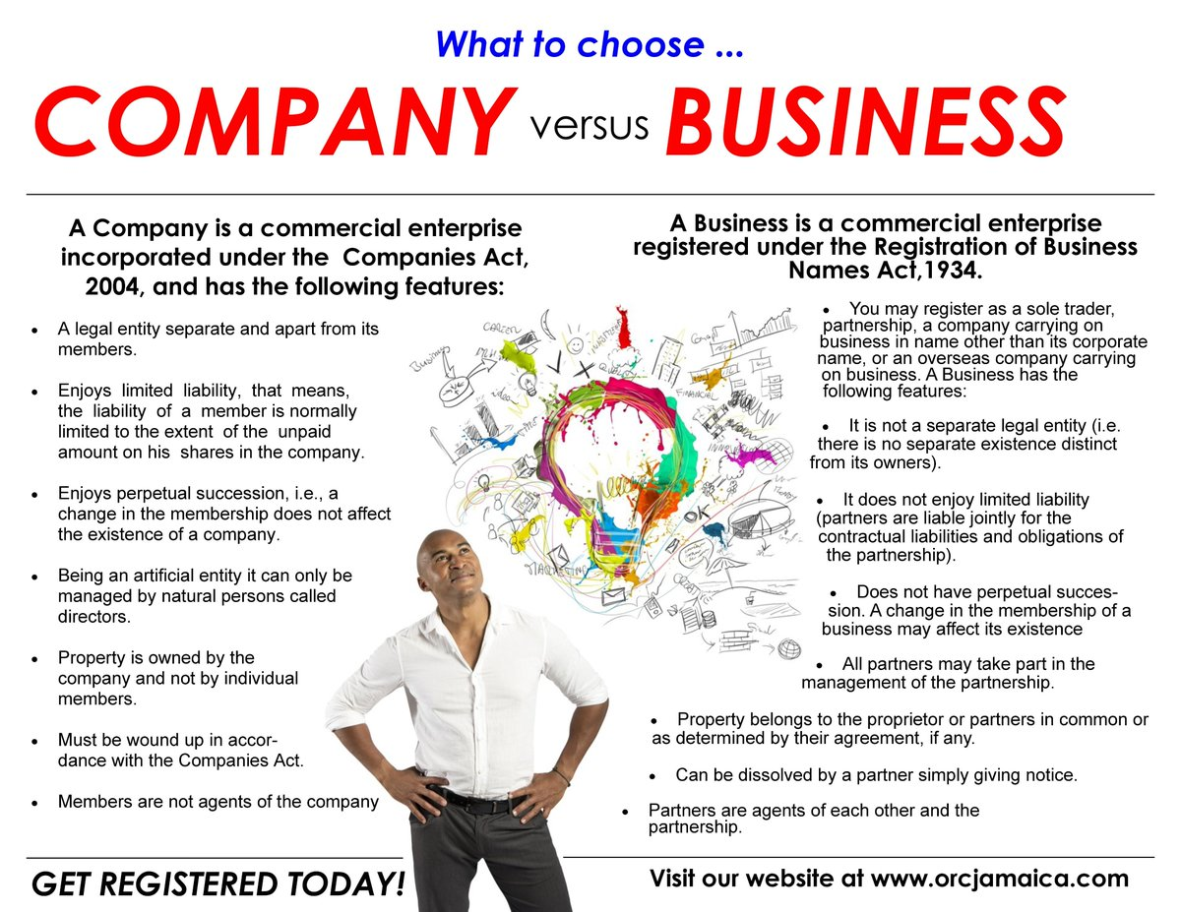

Slide 5
Forms of Business
Sole Proprietorship
Partnership
Corporation
Cooperative
Limited liability companies
Franchises
Company limited by guarantee
Company limited by shares

Slide 6

Key business concepts
Business Plans: It is a formal statement of business goals, reasons they are attainable and plans for reaching them. It is a written description of the business’s future.

Slide 7
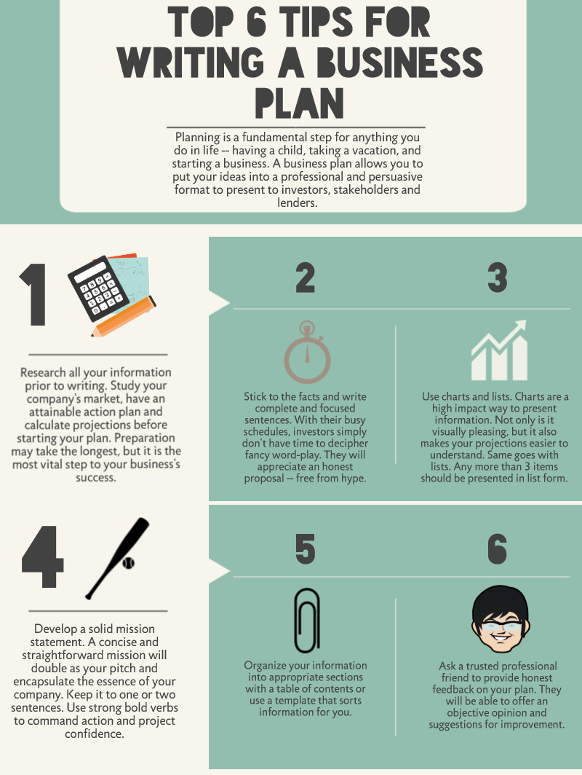
Steps to writing a perfect business plan

Slide 8
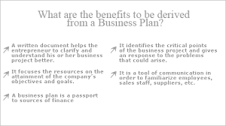
Uses of a Business Plan

Slide 9
Project Management
Project management is the process of leading the work of a team to achieve all project goals within the given constraints. This information is usually described in project documentation, created at the beginning of the development process.
The objective of project management is to produce a complete project which complies with the client's objectives.

Slide 10
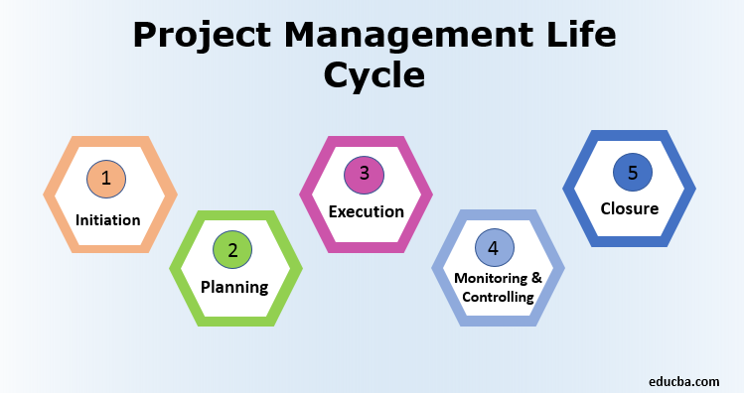

Slide 11
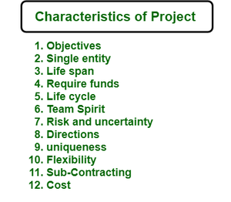

Slide 12
Thank You

